Slide 1

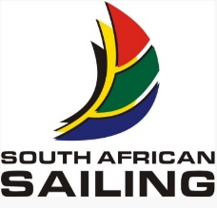
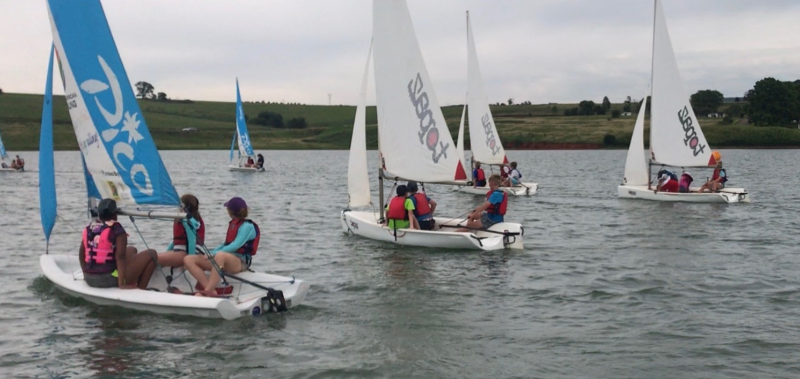
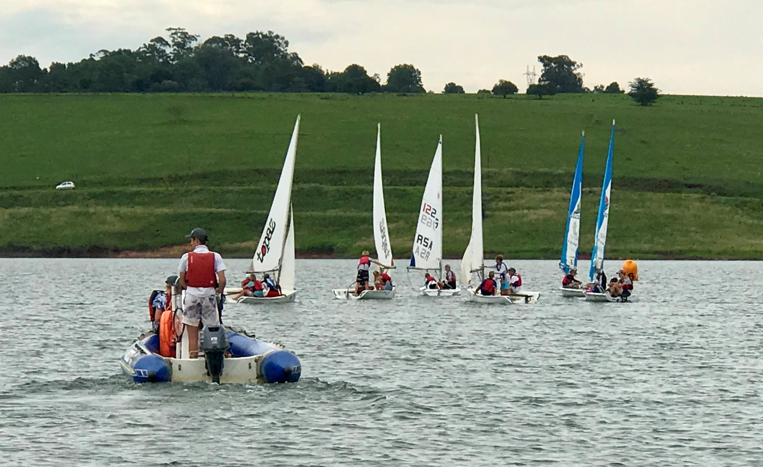
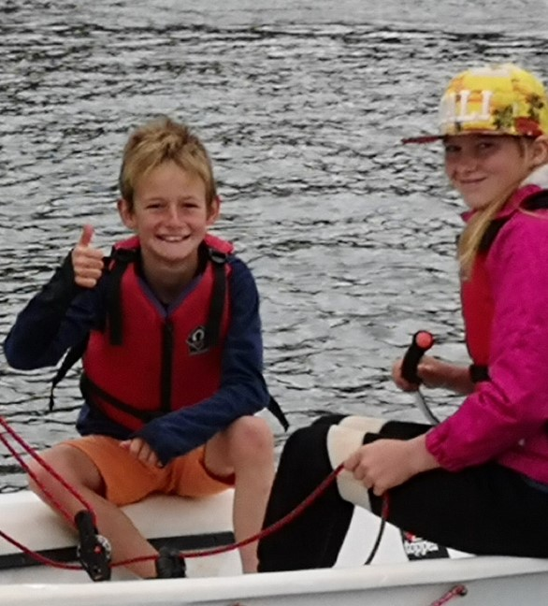
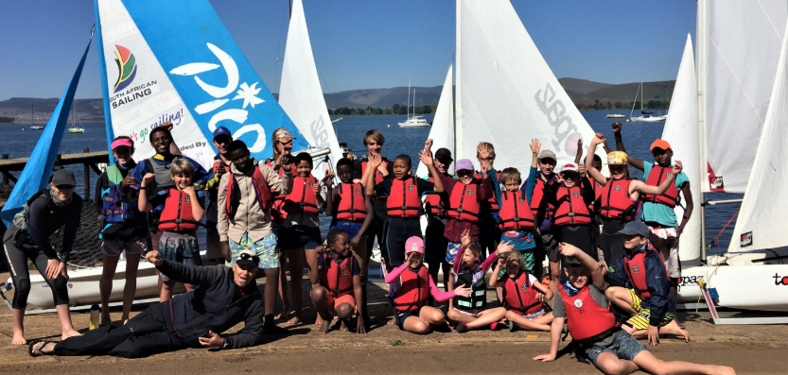
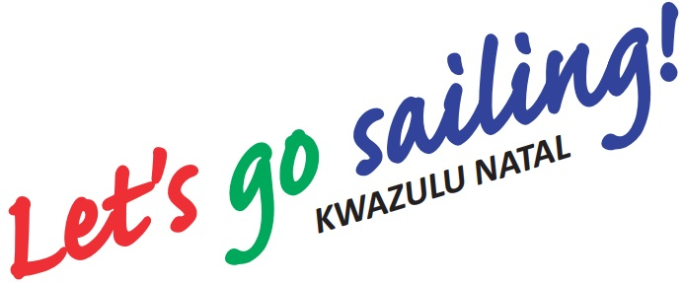

Youth Sailing Courses
These courses are always very popular so BOOK EARLY TO SECURE YOUR PLACE
Level 1 course “My introduction to sailing”
Level 2, 3 or 4 courses “Building my knowledge” “Getting to know my boat” and “Improving my skills”
10 - 13 December 2019
7 - 10 January 2020
24 - 27 March 2020
23 - 26 June 2020 advanced only
HENLEY MIDMAR YACHT CLUB Incorporating Midlands Sailing School
Email: hmyc@mweb.co.za
Camp for 4 days during the holidays, have fun and learn to sail.
* R1250 for the first child.
* R900 for the second child.
* R650 for the third child.
Funding from KZN Dept of Sport and Recreation for development sailors, those with a disability and females, to address inequality in sport.

